Slide 1
CUSTOMER LIFETIME VALUE
PREDICTION & SEGMENTATION
ALIREZA ALIZADEGAN

Slide 2
BUSINESS PROBLEM
Organizations rely on less than 20% of their customers to generate 80% of their revenue
It is 5 times more costly to acquire new customers than it is to maintain existing ones

Slide 3

THE OBJECTIVE:
Identify and keep top customers

Slide 4
THE OUTCOMES
01
02
SALES STRATEGY
MARKETING STRATEGY
Supervised Classification Model to Use Sales Lead Data to Predict and Target Top Customers by Annual Revenue
Unsupervised Clustering Model to Develop Segmented Marketing Strategy with Cluster Characteristics

Slide 5
THE APPROACH
DATA &
REQUIREMENTS
GATHERING
Develop project plan with management
Obtained two years transaction history from an e-commerce comp
Created customer demographics (Location, Size, Industry)
Extracted customer transaction history
FEATURE
ENGINEERING
DATA CLEANING
& EXPLORATION
Merged and cleaned datasets
Examined relationship between revenue/frequency/recency and features
Model selection using ROC-AUC curves
Hyperparameter optimization with cross validation
Scoring on precision & ROC-AUC
MODEL TRAINING
& OPTIMIZATION
MODEL TESTING

Slide 6
CUSTOMER VALUE PREDICTIONS
FEATURE ANALYSIS
HIGH VALUE CUSTOMERS
LOW VALUE CUSTOMERS
Products
Products
FABRIC
VINYL
BANNERS
LAMINATES
Location
Location
SURREY RICHMOND
SQUAMISH
ISLAND
Industry
Industry
FOOD
RETAIL
MANUFACTURING & DISTRIBUTION
LOGGING & MINING

Slide 7
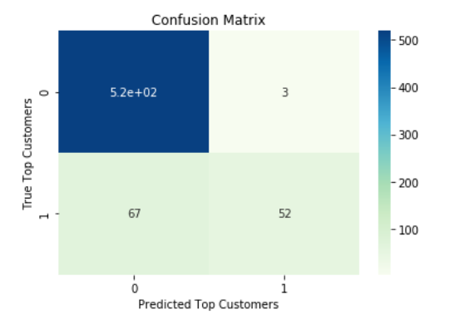
CUSTOMER VALUE PREDICTIONS
SUPERVISED MODEL RESULTS
XGBoost Classification Model Test
IMPACT
Additional Annual Revenue from Obtaining 50 Predicted Top Customers
$283,700/Year

Slide 8
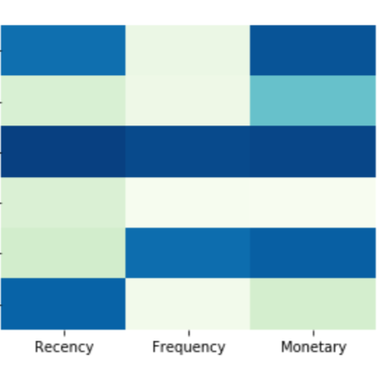

CUSTOMER CLUSTERING
MARKETING STRATEGY
K MEANS CLUSTERING RESULTS
SEGMENT |  |  | MARKETING STRATEGY
POTENTIAL LOYALIST |  |  |  | Offer Loyalty Incentives & Market New Products
HIBERNATING |  |  |  | Promote Relevant Products
CHAMPIONS |  |  |  | Reward Loyalty & Market New Products
LOST |  |  |  | No Attempt to Reacquire
CAN’T LOSE |  |  |  | Aggressive Price Incentives & Build Relationship
NEW CUSTOMERS |  |  |  | Special Welcome Offers

Slide 9
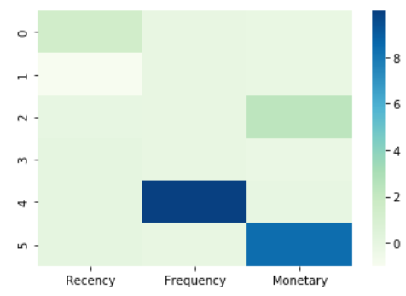
CUSTOMER SEGMENTATION
MARKETING STRATEGY
K MEANS CLUSTERING RESULTS
SEGMENT |  |  | MARKETING STRATEGY
NEW CUSTOMERS |  |  |  | Special Welcome Offers
LOST |  |  |  | No Attempt to Reacquire
POTENTIAL LOYALIST |  |  |  | Offer Loyalty Incentives & Market New Products
HIBERNATING |  |  |  | Promote Relevant Products
CAN’T LOSE |  |  |  | Aggressive Price Incentives & Build Relationship
CHAMPIONS |  |  |  | Reward Loyalty & Market New Products

Slide 10
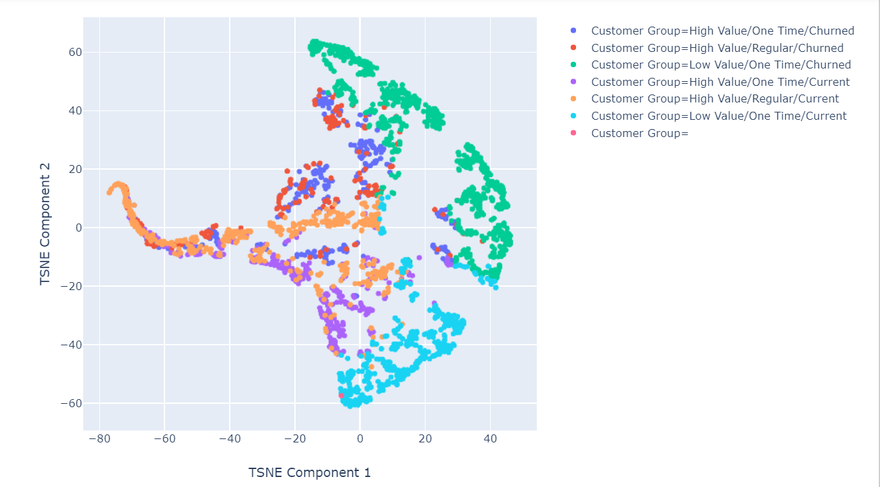
CUSTOMER CLUSTERING
VISUALIZING RESULTS
CUSTOMER CLUSTERS

Slide 11
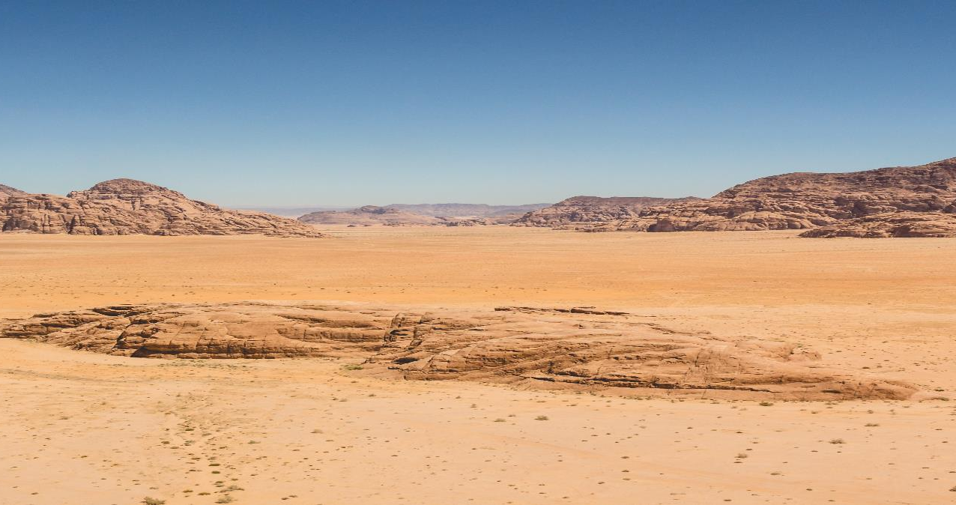

CUSTOMER CLUSTER SEGMENTS
CHURN ANALYSIS
TOP CURRENT CUSTOMERS:
TOP CHURNED CUSTOMERS:
ABOUT: AVG 28 JOBS,ORDERED WITHIN LAST YEAR
INDUSTRIES: LOGGING/MINING, AUTOMOTIVE, PROFESSIONAL SERVICES
REGIONS: ALBERTA, NORTH BC, LOWER MAINLAND, SQUAMISH
PRODUCTS: METAL, BANNER, VINYL, FABRICS, TENTS
ABOUT: AVG 11 JOBS, LARGE, ORDERED 5 YEARS AGO
INDUSTRIES: RETAIL, HOME IMPROVEMENT, REAL ESTATE, FOOD
REGIONS: SURREY, PRAIRIES, US, ISLAND
PRODUCTS: COROPLAST, AWNING FABRIC, FRAMES, WINDOW GRAPHICS

Slide 12

THANK YOU
CONTACT INFORMATION
Data Science
ALIREZA ALIZADEGAN
www.linkedin.com/in/alireza-alizadegan
www.github.com/alireza-alizadegan

